Slide 1
Lagrangian Relaxation and Network Optimization
Cheng-Ta Lee
Department of Information Management
National Taiwan University
September 29, 2005

Slide 2
Outline
Introduction
Problem Relaxations and Branch and Bound
Lagrangian Relaxation Technique
Lagrangian Relaxation and Linear Programming
Application of Lagrangian Relaxation
Summary

Slide 3
Introduction
Basic network flow model
  Shortest paths (ch 4、5)
  Maximum flows (ch 6、7、8)
  Minimum cost flows (ch 9、10、11)
  Minimum spanning trees (ch 13)
  …
The broader models are network problems with additional variables and/or constraints.

Slide 4
Constrained Shortest Paths (CSP)
(c_{ij} , t_{ij})
i
j
c_{ij} : a cost to
traverse link(i,j)
t_{ij} : traveral time
2
(1,1)
4
(1,10)
(2,3)
(1,7)
1
6
(1,2)
(10,1)
(10,3)
(2,2)
(5,7)
3
5
(12,3)

Slide 5
Constrained Shortest Paths (contd.)
Q : We want to find the shortest path from the source node 1 to the sink node 6.
It is required that our choice of paths must no more than T=10 time units to traverse.
2
(1,1)
4
(1,10)
(2,3)
(1,7)
1
6
(1,2)
(10,1)
(10,3)
(5,7)
(2,2)
3
5
(12,3)

Slide 6
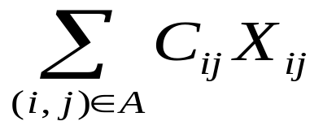
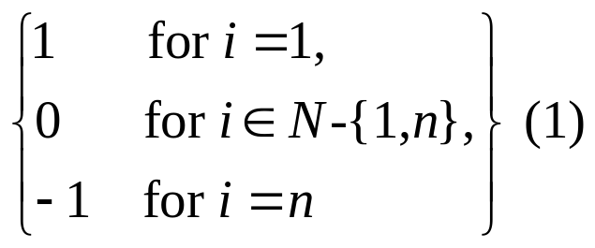
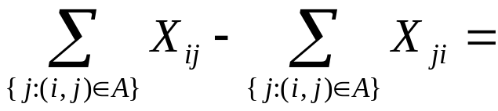
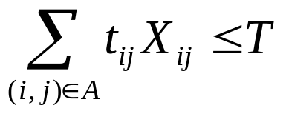

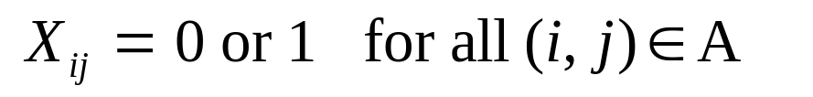

Programming Model
Objective function
Minimize
S.t

Slide 7
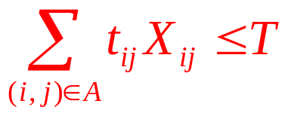
Programming Model
Objective function
Minimize
S.t

Slide 8
Constrained Shortest Paths (contd.)
We combine time and cost into a single modified
cost (c_{ij} +μt_{ij}), that is we place a dollar
equivalent on time.
For example, we might charge $2 (μ=2) for each
hour that it takes to traverse any arc.
Case 1, if the charge is zero, the problem becomes a usual shortest path problem with respect to the given costs.
Case 2, if the charge is very large, the problem become to seek the quickest path.

Slide 9
Constrained Shortest Paths (contd.)
Can we find a charge somewhere in between these values so that by solving the shortest path problem with the combined costs, we solve the constrained shortest path problem as a single shortest path problem?

Slide 10
Constrained Shortest Paths (contd.)
If (μ=0)
2
(1,1)
4
(1,10)
(2,3)
(1,7)
1
(1,2)
6
(10,1)
(10,3)
(5,7)
(2,2)
3
5
(12,3)
2
(1)
4
(1)
(2)
(1)
1
(1)
6
(10)
(10)
(5)
(2)
3
5
(12)

Slide 11
Constrained Shortest Paths (contd.)
If (μ=0)
The shortest path 1-2-4-6 has length 3.
This value is an obvious lower bound since it ignores the timing constraint.
2
(1)
4
(1)
(2)
(1)
1
(1)
6
(10)
(10)
(5)
(2)
3
5
(12)

Slide 12
Constrained Shortest Paths (contd.)
If (μ=2), modified costs (c_{ij} + 2 t_{ij}),
2
(1,1)
4
(1,10)
(2,3)
(1,7)
1
(1,2)
6
(10,1)
(10,3)
(5,7)
(2,2)
3
5
(12,3)
2
3
4
21
8
15
1
5
6
12
16
19
6
3
5
18

Slide 13
Constrained Shortest Paths (contd.)
If (μ=2), modified costs (c_{ij} + 2 t_{ij})
The shortest path 1-3-2-5-6 has length 35 and require 10 units to traverse, so it is a feasible constrained shortest path.
Is it an optimal constrained shortest path?
2
3
4
21
15
1
8
5
2
12
6
3
16
6
2
3
19
3
5
18

Slide 14
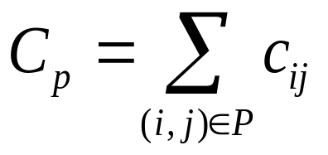
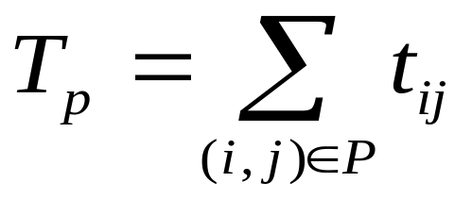
Constrained Shortest Paths (contd.)
Let P be any feasible path to the constrained shortest path problem
With cost and
traversal time

Slide 15
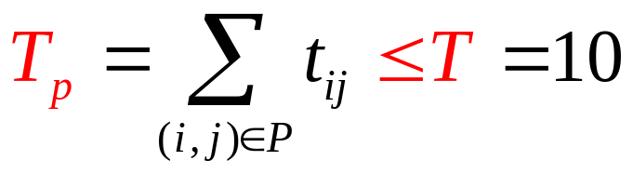
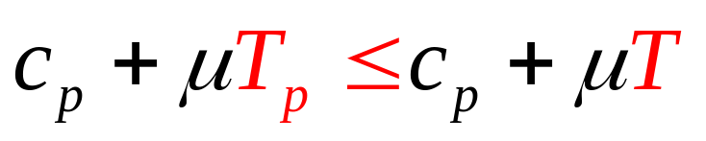
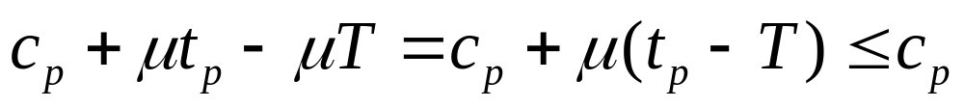
Constrained Shortest Paths (contd.)
Since the path P is feasible solution,
And subtracting μT from the modified cost
c_{p}+μt_{p}, we obtain a lower bound

Slide 16
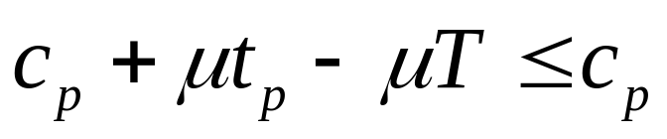
Bounding Principle
For any nonnegative value of the toll μ, the optimal value of the modified shortest path with cost c_{ij}+μt_{ij} minus μT is lower bound on the value of the constrained shortest path.

Slide 17
Bounding Principle
μ=2, the cost of the modified shortest path problem is 35
So 35 – 2 (T) = 35 – 2 (10) = 15 is lower bound.
But since the path 1-3-2-5-6 is a feasible solution to the CSP and its cost equals to 15 units, we can be assured that it is an optimal constrained shortest path.
2
(1,1)
4
(1,10)
(2,3)
(1,7)
1
(1,2)
6
(10,1)
(10,3)
(5,7)
(2,2)
3
5
(12,3)

Slide 18
Introduction (contd.)
In this example we solve a difficult optimization model (the CSP problem is an NP–complete problem) by removing one or more problem constraints that makes the problem much more difficult to solve.
Rather than solving the difficult optimization problem directly, we combined the complicating timing constraint with the original objective function, via the toll μ, so that we could then solve a resulting embedded shortest path problem.

Slide 19
Introduction (contd.)
Motivation : the original constrained shortest path problem had an attractive substructure, the shortest path problem, that we would like to exploit algorithmically.
Whenever we can identify such attractive substructure, we could adopt a similar approach.

Slide 20
16.2 Problem relaxations and branch and bound
Bounding Principle (lower bounds) can be of considerable value:
  Ex: for our CSP problem, we use a lower bound to demonstrate that a particular solution was optimal.
In general, we will not always so lucky. Nevertheless, we still be able to use lower bounds as an algorithmic tool in reducing the number of computations required to solve combinatorial optimization problems formulated as integer programs.

Slide 21
Integer programming model
Objective function
Minimize cx
subject to
Ax=b
X_{j} = 0 or 1 for j = 1,2,…,J.

Slide 22
Integer programming model
Objective function
Minimize cx
subject to
Ax=b
X_{j} = 0 or 1 for j = 1,2,…,J.
if a problem with 100 decision variables, even if we could
compute one solution very nanosecond
all 2¹⁰⁰ solutions would take over million million years

Slide 23
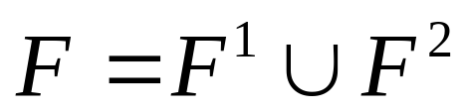
Integer programming model
Let F represents the set of feasible solutions to an integer programming
Suppose that
For example, we might obtain F ¹ from F by adding the constraint x₁=0 and F ² by adding the constraint x₁=1
The optimal solution over the feasible set F is the best of the optimal solutions over F ¹ and
F ².

Slide 24
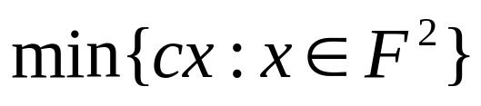
Integer programming model
Suppose we have found an optimal solution x to
and its objective function value is
z(x)=100
The number of potential integer solution in F ¹ is still 2^{J-1}, so it will be prohibitively expensive to enumerate all these possibilities, except when J is small.

Slide 25
Relaxed version of the problem
Rather than solve the problem over F ¹ , we solve a relaxed version of the problem
  Possible by relaxing the integrality constraints
  And/or by performing a LR method.
We relax some constraints and the objective function value of the relaxation is a lower bound on the objective function value of the original problem.

Slide 26
Relaxed version of the problem
Let x’: an optimal solution to the relaxation
z(x’): the objective function value of this solution
Four possibilities:
  x’ does not exist.
  x’ lies in F ¹ (even though we relaxed some of the constraints)
  x’ does not lie in F ¹ and its objective function value z(x’) satisfies the inequality z(x’) ≧ z(x) = 100
  x’ does not lie in F ¹ and its objective function value z(x’) satisfies the inequality z(x’) < z(x) = 100

Slide 27
Relaxed version of the problem
Case 1: x’ does not exist. (F ² ’s z(x)=100 optimal solution)
  Solution x solves the original integer program
Case 2: x’ lies in F ^{1 →} we found the best solution in F ¹
  Either x or x’ is the solution to the original problem
Case 3: x’ does not lie in F ¹ and its objective function value z(x’) satisfies the inequality z(x’) ≧ z(x) = 100
  x solves the original problem
  In this case, We use bounding information on the objective function value to eliminate the solutions in the set F ¹ from further consideration.
  z(x’) is a lower bound

Slide 28
Relaxed version of the problem
Case 4: x’ does not lie in F ¹ and its objective function value z(x’) satisfies the inequality z(x’) < z(x) = 100
  We have not yet solved the original problem.
  Either try to solve the problem by some direct method of integer programming or, we can partition F ¹ into two sets F ³ and F ⁴

Slide 29
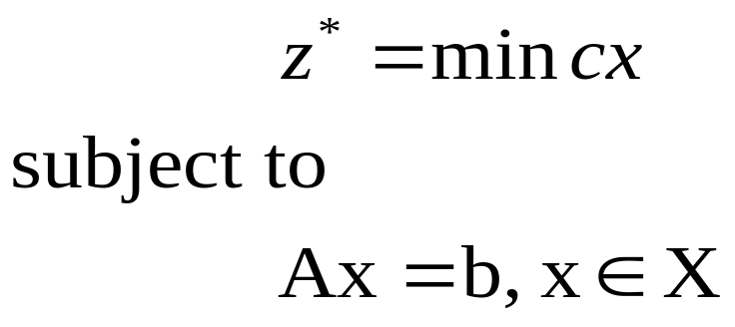
16.3 Lagrangian Relaxation
Consider the following generic optimization model formulated in terms of a vector x
Lagrangian relaxation procedure uses the idea of relaxing the explicit linear constraints by bringing them into the objective function with associated Lagrange multiplier μ.
(P)

Slide 30
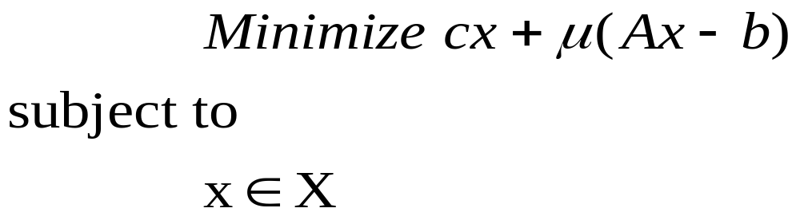
Lagrangian Relaxation (cont’d)
Translating the original problem into Lagrangian relaxation problem (Lagrangian subproblem) as the following form
and referring the following form as Lagrangian function

Slide 31

Lagrangian Relaxation (cont’d)
Lemma 1 (Lagrangian Bounding Principle).
  For any vector μ of the Lagrangian multipliers, the value L(μ) of the Lagrangian function is a lower bound on the optimal objective function value z* of the origianl optimization problem.
Proof:
  Since Ax=b for every feasible solution to (P), for any vector μ of Lagrangian multipliers,
  z*= min{cx : Ax=b,x X}=min{cx + μ(Ax-b):Ax=b,x X}.
  Since removing the constraints Ax=b from the second formulation cannot lead to an increase in the value of the objective function (the value might decrease),
  z*≧ min{ cx +μ(Ax-b): x X}=L(μ).
=0

Slide 32
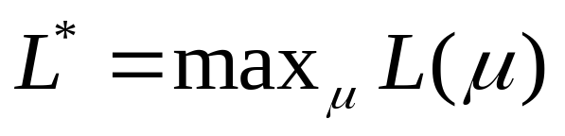
Lagrangian Relaxation (cont’d)
To obtain sharpest possible lower bound, we would need to solve the following optimization problem referred to as Lagrangian multiplier problem.

Slide 33
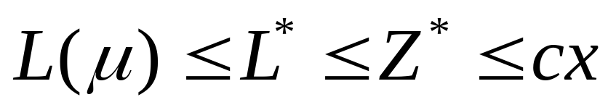
Lagrangian Relaxation (cont’d)
Weak Duality
  The optimal objective function value L* of the Lagrangian multiplier problem is always a lower bound on the optimal objective function value of the original problem.

Slide 34
Optimality Test (a)
suppose that μ is a vector of Lagrangian multipliers and x is a feasible solution to the optimization problem (P) satisfying the condition L(μ) = cx. Then
  L(μ) is an optimal solution of the Lagrangian multiplier problem. [i.e., L* = L(μ)]
  x is an optimal solution to the optimization problem (P).
Proof:

Slide 35
Optimality Test (b)
If for some choice of Lagrangian multipliers vector μ, the solution x* of the Lagrangian relaxation is feasible in the optimization problem (P), then
  x* is an optimal solution to the optimization problem (P)
  μ is an optimal solution to the Lagrangian multiplier problem.
Proof:
  L(μ) = cx* + μ (Ax*- b) , and Ax* = b
  Therefore, L(μ) = cx* and (a) implies that x* solves problem (P) and μ solves the Lagrangian multiplier problem.

Slide 36
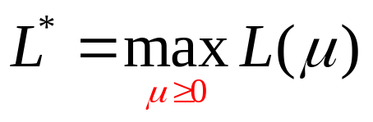
Lagrangian Relaxation and Inequality Constraints
In practice, we often encounter models that are formulated in inequality form Ax ≦ b
The Lagrangian multiplier problem becomes
When we relax inequality constraints Ax ≦ b, if the solution x* satisfy these constraints, it need not be optimal.
In addition to being feasible, this solution needs to satisfy the complementary slackness condition
μ (Ax* - b)=0

Slide 37
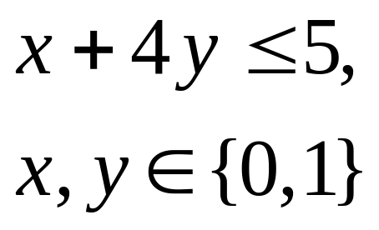
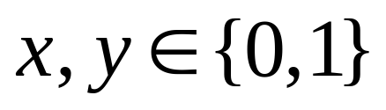
Example 16.2
Objective Function
  Minimize -2x -3y
s.t
Corresponding relaxed problem
Minimize -2x -3y + (x + 4y - 5)
s.t
(0,0) = 0
(1,0) = -2
(0,1) = -3
(1,1) = -5
(0,0) = -5
lower bound (1,0) = -6
(0,1) = -4
(1,1) = -5

Slide 38

Property 4
Suppose that we apply Lagrangian Relaxation to the optimization problem (P ≦) defined as min{cx : Ax ≦ b and x X} by relaxing the inequalities Ax ≦ b. suppose, further, that for some choice of the Lagrangain multiplier vector μ, the solution x* of the Lagrangian relaxation
  (1) is feasible in the optimization problem
  (2) satisfies the complementary slackness condition.
  Then x* is an optimal solution to the optimization problem

Slide 39
Proof
By assumption, L(μ) = cx* + μ(Ax* -b). Since μ(Ax* -b)=0, L(μ) = cx*. Moreover, since Ax* ≦ b, x* is feasible, and so by Optimality test (a) x* solves problem (P ≦)

Slide 40
Discussion
Case 1: use optimality test (a) and (b) show that certain solutions of the Lagrangian subproblem solve the original problem.
Case 2: when solutions obtained by relaxing inequality constraints are feasible but are not provably optimal for the original problem.
Case 3: when solutions to the Lagranginan relaxation are not feasible in the original problem.
  Getting Primal Feasible Solution
Candidate optimal solutions (ex. For branch and
bound procedure) → lower bound

Slide 41
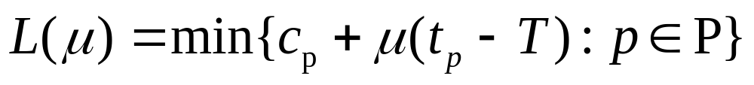
Solving the Lagrangian Multiplier Problem
Consider the constrained shortest path problem.
Suppose that now we have a time limitation of T=14 instead of T=10.
We relax the time constraint, the Lagrangian function L(μ) becomes
which P is the collection of all directed paths from node 1 to the node n.

Slide 42
2
(1,1)
4
(1,10)
(2,3)
(1,7)
1
6
(1,2)
(10,1)
(10,3)
(2,2)
(5,7)
3
5
(12,3)

Slide 43
Intercept
Slope
Path p | Path cost c_{p} | Path time t_{p} | Composite cost c_{p} +μ(t_{p} – T)
1-2-4-6 | 3 | 18 | 3+4μ
1-2-5-6 | 5 | 15 | 5+μ
1-2-4-5-6 | 14 | 14 | 14
1-3-2-4-6 | 13 | 13 | 13-μ
1-3-2-5-6 | 15 | 10 | 15-4μ
1-3-2-4-5-6 | 24 | 9 | 24-5μ
1-3-4-6 | 16 | 17 | 16+3μ
1-3-4-5-6 | 27 | 13 | 27-μ
1-3-5-6 | 24 | 8 | 24-6μ

Slide 44
Paths
40 30 20 10 0
1-3-4-6
16+3μ
Composite cost
cp +μ(tp – T)
1-2-4-6
1-3-4-5-6
1-2-4-5-6
1-2-5-6
1-3-2-4-6
1-3-2-4-5-6
1-3-2-5-6
1-3-5-6
-10
0 1 2 3 4 5
Lagrange multiplier μ

Slide 45
Paths
40 30 20 10 0
1-3-4-6
Composite cost
cp +μ(tp – T)
1-2-4-6
1-3-4-5-6
1-2-4-5-6
1-2-5-6
1-3-2-4-6
Lagrangian function L(μ)
1-3-2-4-5-6
1-3-2-5-6
1-3-5-6
-10
0 1 2 3 4 5
Lagrange multiplier μ

Slide 46
Solving the Lagrangian Multiplier Problem
Exhaustive search: prohibitively expensive.
Gradient method: can’t solve the Lagrangian subproblem which has two or more solutions. In this case, the Lagrangian function generally is not differentiable.
Subgradient method

Slide 47
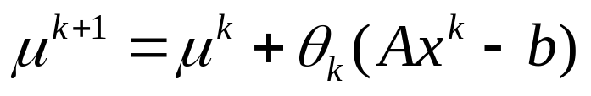
Subgradient Method
Adaptation of the gradient method in which gradient are replace by subgradient.
Given an initial value μ⁰, a sequence {μ^{k}} is generated by the rule
where x^{k} is an optimal solution to Lagrangian subproblem and θ_{k} is a positive scalar step size.
This procedure has a nice intuitive interpretation.

Slide 48
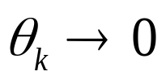
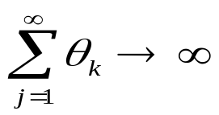
Subgradient Method (cont’d)
A theoretical result is that L(μ_{k})->L* if following two conditions have been satisfied.
Ex: 1/k

Slide 49
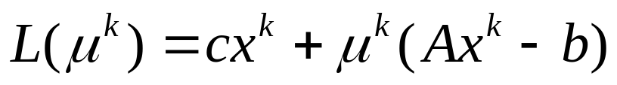
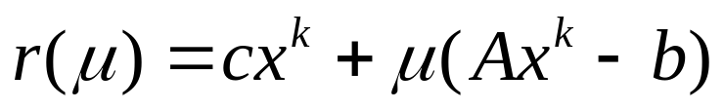
How to find θ_{k}
Which x^{k} solves the Lagrangian subproblem
Assume x^{k} continues to solve the Lagrangian subproblem as we vary μ
Then we can make a linear approximation
to L(μ)

Slide 50
Paths
40 30 20 10 0
Composite cost
cp +μ(tp – T)
1-2-4-6
1-2-5-6
Lagrangian function L(μ)
1-3-2-5-6
-10
μ^{k}=0
1 2 3 4 5
Lagrange multiplier μ

Slide 51
Paths
40 30 20 10 0
Composite cost
cp +μ(tp – T)
1-2-4-6
Liner approximation r(μ) of L(μ)
1-2-5-6
Lagrangian function L(μ)
1-3-2-5-6
-10
μ^{k}=0
1 2 3 4 5
Lagrange multiplier μ

Slide 52
Since L* = 7 and c_{p} = 3
r(μ) = 3 + 4μ
Set 3 + 4μ = 7
μ^{k+1} = (7-3)/4=1
Paths
40 30 20 10 0
Composite cost
cp +μ(tp – T)
1-2-4-6
Liner approximation r(μ) of L(μ)
1-2-5-6
L* = 7
Lagrangian function L(μ)
1-3-2-5-6
-10
μ^{k}=0
1 2 3 4 5
μ^{k+1}=1
Lagrange multiplier μ

Slide 53
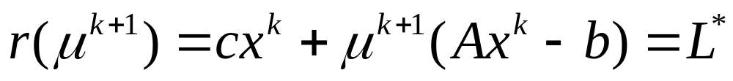
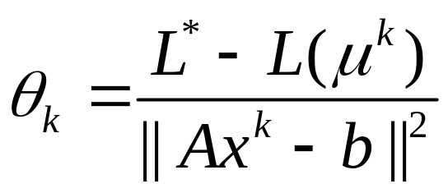
How to find θ_{k} (cont’d)
We set the step length θ_{k} so that
Since
We can find that

Slide 54
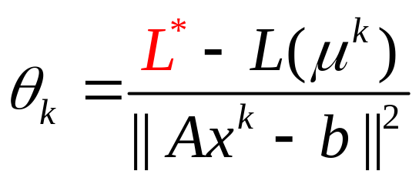
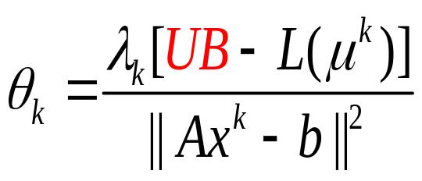

How to find θ_{k} (cont’d)
where
UB: an upper bound on the optimal objective
function value z* of original problem.
: a scalar size between 0 and 2.

Slide 55
Subgradient Method (cont’d)
Initially, the upper bound (UB) is the objective function of any known feasible solution to the original problem.
As the algorithm proceeds, if it generates a better feasible solution, it uses the objective function value of this solution in place of the former upper bound.
How to find initial upper bound?

Slide 56
Subgradient Method (cont’d)
usually starts with = 2 and then reducing by a factor of 2 whenever the best Lagrangian objective function value found so far has failed to increase in a specified number of iterations.
Since this version of the algorithm has no convenient stopping criteria, practitioners usually terminate it after it has performed a specified number of iterations.

Slide 57

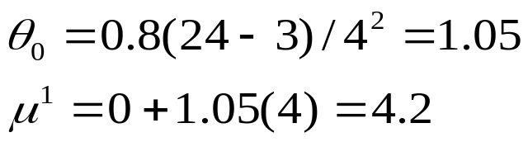
Illustrative Example
Constrained Shortest Path Problem
  Initial: choose μ⁰=0, =0.8 and with UB=24, the cost corresponding to the shortest path 1-3-5-6.
  The solution x⁰ to the Lagrangian subproblem with μ⁰=0 corresponds to the path P=1-2-4-6
  L(μ⁰=0)=3, and the subgradient Ax⁰-b at μ⁰ is
  At the first step, choose
  and then iteration by iteration.
  (t_{p}-14)=18-14=4
UB L(0)
μ₀ θ_{k}

Slide 58
2
(1,1)
4
(1,10)
(2,3)
(1,7)
1
6
(1,2)
(10,1)
(10,3)
(2,2)
(5,7)
3
5
(12,3)

Slide 59
k | μ^{k} | T_{p}-T | L(μ^{k}) | λ_{k} | Θ_{k}
0 | 0.0000 | 4 | 3.0000 | 0.8000 | 1.0500
1 | 4.2000 | -4 | -1.8000 | 0.8000 | 0.8400
2 | 0.84.. | 4 | 6.3600 | 0.8000 | 0.4320
3 | 2.5680 | -4 | 4.7280 | 0.8000 | 0.5136
4 | 0.5136 | 4 | 5.0544 | 0.8000 | 0.4973
5 | 2.5027 | -4 | 4.9891 | 0.4000 | 0.2503
. . . | . . . | . . . | . . . | . . . | . . .
29 | 2.0050 | -4 | 6.9800 | 0.00250 | 0.0013
30 | 2.0000 | -4 | 7.0000 | 0.00250 | 0.0012
31 | 1.9950 | 1 | 6.9950 | 0.00250 | 0.0200
32 | 2.0150 | -4 | 6.9400 | 0.00250 | 0.0013
33 | 2.0100 | -4 | 6.9601 | 0.00125 | 0.0006

Slide 60
Conclusion
In this example, the optimal multiplier objective function value L* = 7
But the length of the shortest constrained path is 13
7 ≠ 13, we say that the Lagrangian relaxation has a duality (relaxation) gap.
  ((UB-LB)/LB)*100%

Slide 61
Lagrangian Relaxation and Linear Programming
Theorem 16.6
Suppose that we apply Lagrangian relaxation technique to a linear programming problem(P’) define as min {cx:Ax=b,Dx≦q , x≧0} by relaxing the constraints Ax-b. Then the optimal value of the Lagrangian multiplier problem equals the optimal objective function value of (P’).

Slide 62
Lagrangian Relaxation and Linear Programming
Discrete optimization problem (P):
  z* = Min{cx: Ax=b , Dx ≦ q , x ≧ 0 and integer}
Let (LP): linear programming relaxation of problem (P) : min{cx: Ax=b , Dx ≦ q , x ≧ 0 }
Let z⁰: optimal objective function value of LP
  z⁰ = min{cx: Ax=b , Dx ≦ q , x ≧ 0 }
  z⁰ ≦ z*
Review Lagrangain multiplier problem also gives a lower bound L* , L* ≦ z*
z⁰ vs L* ?
z⁰ ≦ L*

Slide 63
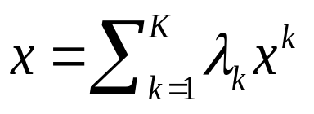
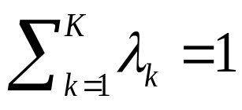
Convex combination and Convex Hull
Suppose X={x¹, x², …x^{K} } is a finite set. We say a solution is a convex combination of X if for some nonnegative weightsλ₁ , λ_{2 ……}λ_{k} , satisfying the condition .
Let H(X) denote the convex hull of X(ex., the set of all convex combinations of X) and it has three properties.

Slide 64
Convex Hull (Property cont.)
(a) The set H(X) is a polyhedron expressed as a solution space defined by a finite number of linear inequality.
(b) Each extreme point solution of the polyhedron H(X) lies in X , and if we optimize a linear objective function over H(X), some solution in X will be an optimal solution.
(c) The set H(X) is contained in the set of solution{x:Dx≦q, x≧0}

Slide 65
Proof
(c) The set H(X) is contained in the set of solution{x:Dx≦q, x≧0}
Since every solution in X also belongs to the convex set {x:Dx≦q, x≧0}, and consequently, every convex combination of solutions in X, which defines H(X), also belongs to the set solution{x:Dx≦q, x≧0}

Slide 66

Lagrangian Relaxation and Linear Programming Relaxation
Theorem 16.8: The optimal objective function value L* of Lagrangian multiplier problem equals to the optimal objective function value of the linear program min{cx:Ax=b, }
Theorem 16.9: When applied to integer programs stated in minimization form, the lower bound obtained by Lagrangian relaxation technique is always as large as the bound obtained by the linear program relaxation of the problem.(z⁰ ≦L* )

Slide 67

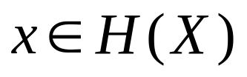
Lagrangian Relaxation and Linear Programming Relaxation(Proof cont. 1)
Proof:
Consider the Lagrangian subproblem
L(μ) =min {cx+μ(Ax-b): }.
For some choices μ of Lagrangian multiplier, the original problem is equivalent to the problem
L(μ)=min{cx+μ(Ax-b): }.
And by recover the LR problem to primal problem , we can conceive of the Lagrangian subproblem as a relation of the following LP problem
min{cx: Ax=b , }
by Theorem 16.6 L* = min{cx: Ax=b , }
By Convex Hull (b)
By Convex Hull (a)

Slide 68
Theorem 16.9: When applied to integer programs stated in minimization form, the lower bound obtained by Lagrangian relaxation technique is always as large as the bound obtained by the linear program relaxation of the problem.(z⁰ ≦L* )

Slide 69
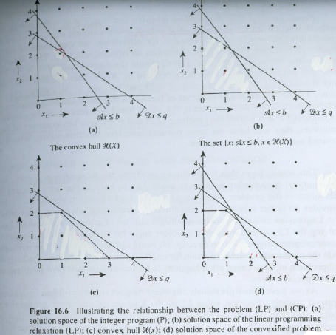
(Proof cont. 2)
IP
LP
Convex Hull
LR

Slide 70

Application of Lagrangian Relaxation (Networks with side constraints)
The constrained shortest path problem is a special case of a broader set of optimization models known as network flow problems with side constraints:
Minimize cx
subject to
Ax≦b(Side constraints)
Nx=q(Flow balance constraints)
l ≦x≦u and x_{ij} is integer for all

Slide 71
Networks with side constraints(cont.)
Side constraints (Ax≦b) can be modeled as resources constraints, time delay, limited capacity or cost budget etc.
Flow balance constraints (Nx=q) can be also modeled as demand=supply constraint.
By Lagrangian relaxation, we obtain the following subproblem (shortest path problem)
minimize{cx+u(ax-b): Nx=q,l ≦x≦u }

Slide 72
Summary
Lagrangian relaxation provides a bounding principle that the optimal value of LR is always a lower bound on the objective function of the original problem(P).
L(u) ≦L*≦Z*
In dual relaxed problem, we maximize the optimal value of L(u) to be close to the original feasible region of (P) and get a tightest upper bound as possible.

Slide 73
Summary(cont.)
The LP problem’s lower bound is looser than LR’s and LR’s lower bound is at least as large as LP’s. (z⁰ ≦L* )
Form applications, we expect to relax some complicate constraints and reduce the original problem to subproblems with core network structures- shortest path, minimum cost spanning tree, the assignment problem and min cost flow- so we can apply some developed and elegant algorithm on them.

Slide 74
Q & A

